Slide 1
CSCE 623 In Class Day 12
Synchronous session

Slide 2
Agenda
Key points for regularization Part 2
Curse of Dimensionality Coding Demo
Break
Discussion on Student->Instructor Feedback
Questions & Project Discussion

Slide 3
Key Points for Regularization (Part 2)
PCA for dimension reduction
Curse of Dimensionality (includes theory & coding)

Slide 4
PCA for dimension reduction
Lossy transformation of FEATURES into lower dimension space
https://scikit-learn.org/stable/modules/generated/sklearn.decomposition.PCA.html
Hyperparameter: Choose number of components to keep
Might choose based on explained variance / scree plot
Alternative: Choose using validation methods of a model fit to PCA-transformed data
The PCA-returned components are no longer in the original space of the data
Need an inverse PCA transform to reobtain (a lossy reproduction) of the original feature values if they are needed
More on this during unsupervised learning…

Slide 5
Curse of Dimensionality
More features allow more information for the model to be fit from – and allow complex relationships between features and the response variable to be learned…. BUT:
With more features, the distance between datapoints in feature space grows….the number of points per unit of volume decreases…
As data density decreases, data becomes sparser…
It becomes easier to overfit a model to the data unless we
Choose higher bias models
Use regularization techniques which reduce the flexibility
Gather more data to increase the density/reduce the sparseness of the space

Slide 6
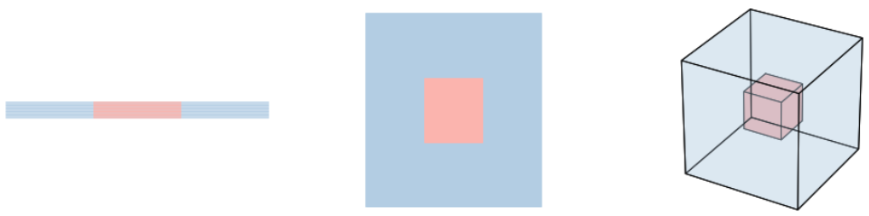
Curse of Dimensionality Whiteboard

Slide 7
Coding Demo – Curse of Dimensionality
Obtain the code from Canvas
Instructor Demo
Explore the student code section to try different dimensions (feature counts)

Slide 8
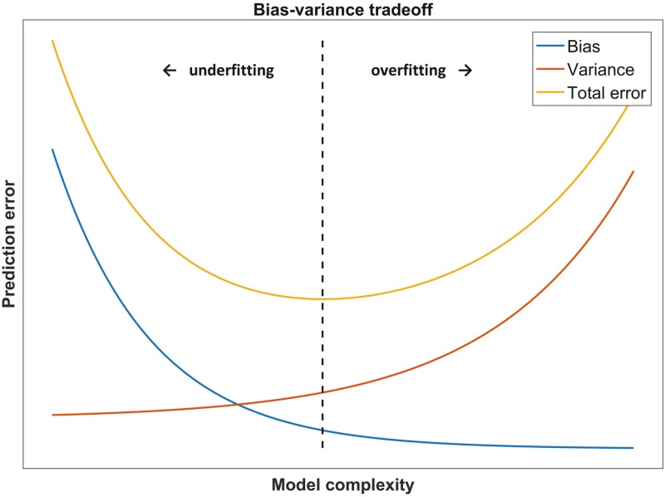
Getting it right:
Gather more features
Gather More Observations
Increase model complexity
Select Fewer Features
Feature Transforms (PCA)
Good Fit = Generalizable
Reduce Model Complexity
Regularization

Slide 9
Questions & Open Project Discussion

